Slide 1
Table I Model design parameters of PMASynRM
Parameter | Quantities
Number of pole | 4 pole
Number of slot | 36 slot
Air gap length | 0.3 mm
Inner diameter of rotor | 31 mm
Outer diameter of rotor | 94.4 mm
Inner diameter of stator | 95 mm
Outer diameter of stator | 160 mm
Stack length | 150 mm

Slide 2
Table II Parameters of PMASynRM drive system
Parameters | Quantities
Rated power | 4.5 kW
Rated phase voltage | 214 V
Rated phase current | 9.4 Arms (delta)
Pole | 4 pole
Slot number | 36 slot
Rated speed | 1500 rpm
Rated torque | 25 Nm
d-axis inductance | 19.6 mH
q-axis inductance | 84.3 mH
Stator resistance | 1.01
Inertia coefficient | 0.0069 Nm/(rad/ )
Damping coefficient | 0.0013 Nm/(rad/sec)
Magnetic flux | 0.0854 Wb
DC-link | 311 V
Sampling interval of current loop/ speed loop | 0.1 ms/ 1 ms
Switching frequency | 10 kHz
Encoder | TAMAGAWA incremental encoder: OIH 48-2500P4-L6-5V 2500 counts/turn

Slide 3
Table III Parameters of IPMSM load
Parameters | Quantities
Rated power | 7.5 kW
Rated voltage | 220 V
Rated current | 36 A
Rated torque | 24 Nm
Rated speed | 3000 rpm

Slide 4
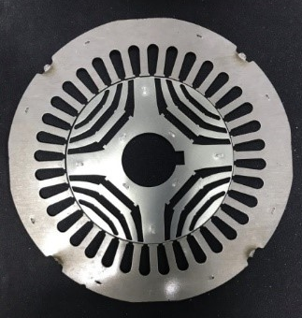
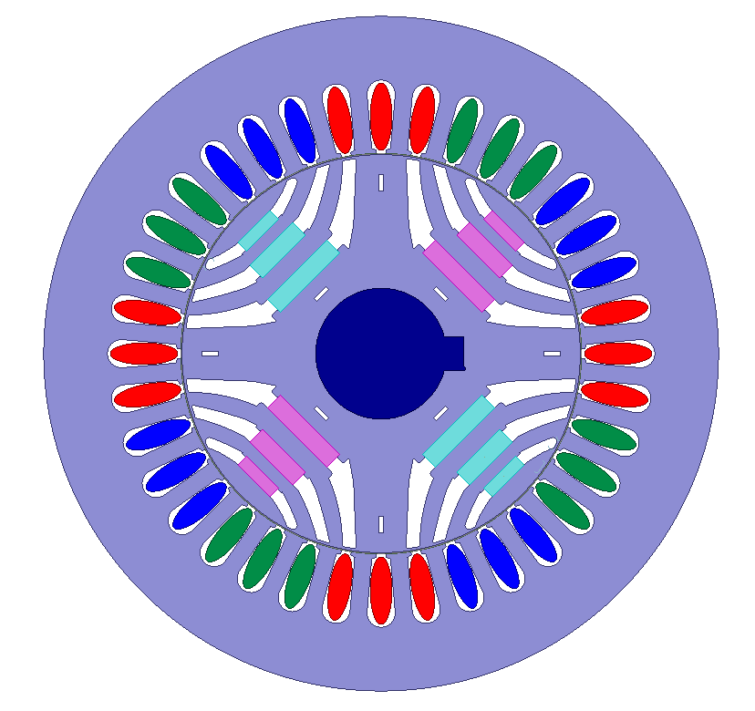
Fig. 1. FEA model of PMASynRM

Slide 5
FEA Simulation
TMTPA Points
β
Fig. 2. Torque versus current angle at various stator current magnitudes by using TMTPA control and MTPA control

Slide 6
Fig. 3. Control block diagram of PMASynRM speed drive system

Slide 7
(a)
(b)
Fig. 4. PI current controllers. (a) q-axis. (b) d-axis.

Slide 8
(a)
(b)
Fig. 5. Bode diagrams of current controllers. (a) q-axis. (b) d-axis.

Slide 9
-
Fig. 6. Relationship between the current vector and the d-q axis

Slide 10
Fig. 7. Control block diagram of PMASynRM speed drive using ICTCRLFNN

Slide 11
Fig. 8. Network structure of RLFNN

Slide 12
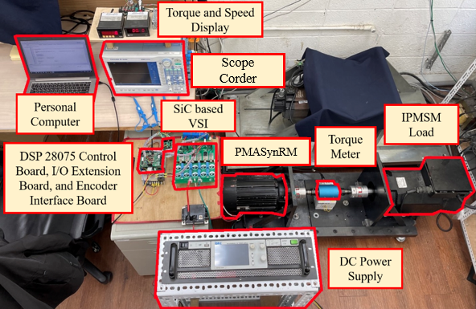
Fig. 9. Photograph of experimental setup.

Slide 13
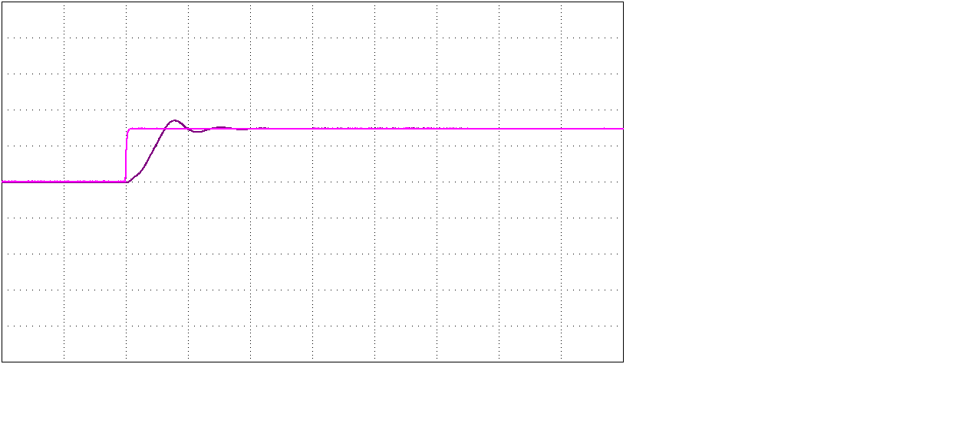
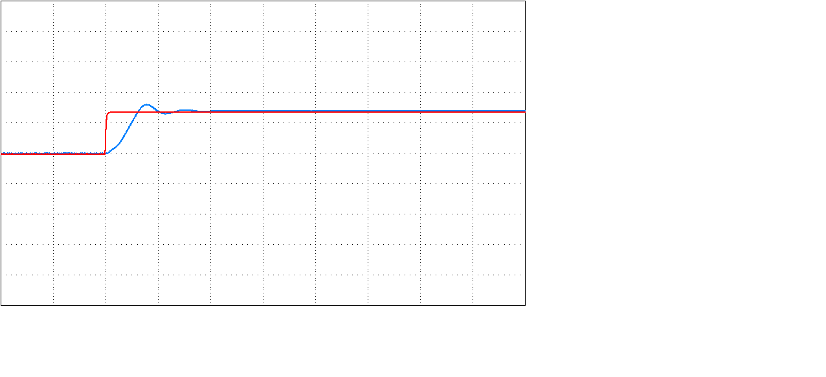
(a)
(b)
Fig. 10. Current responses of qd-axis current control by using PI controllers.
(a) Step command and response of q-axis current. (b) Step command and response of d-axis current.

Slide 14
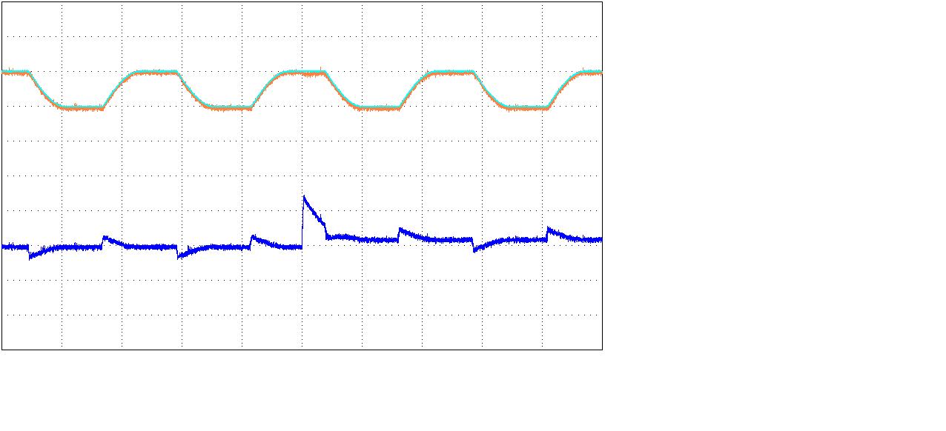
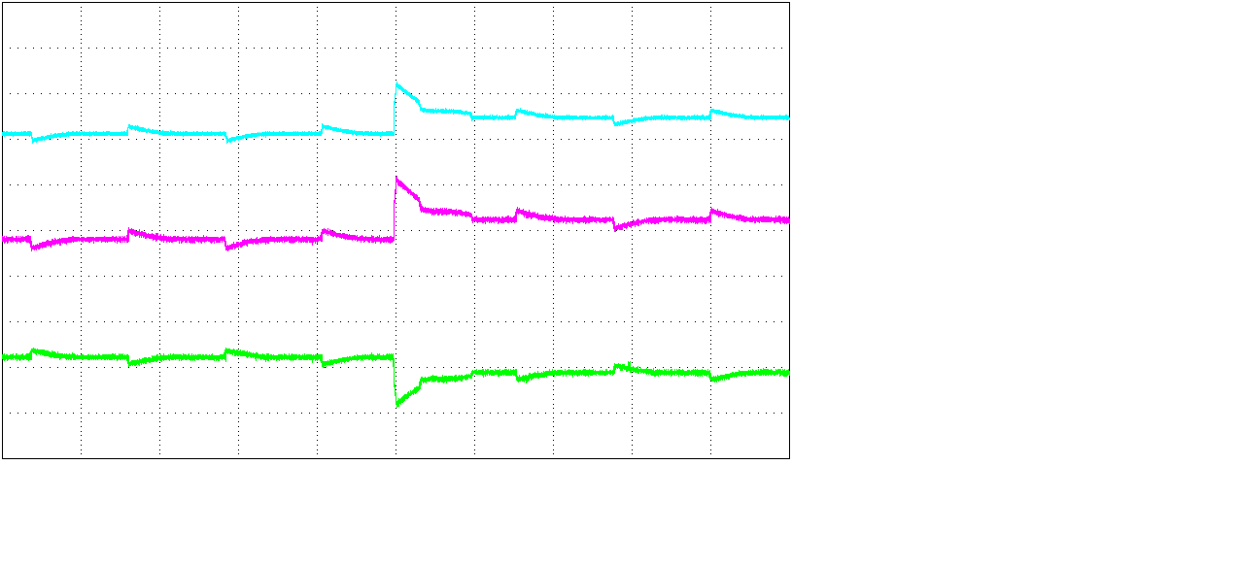
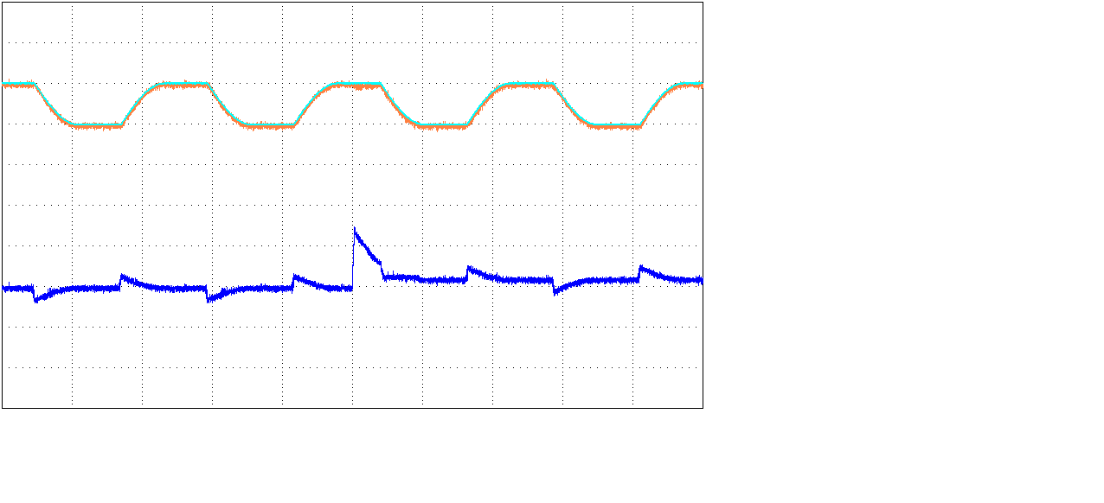
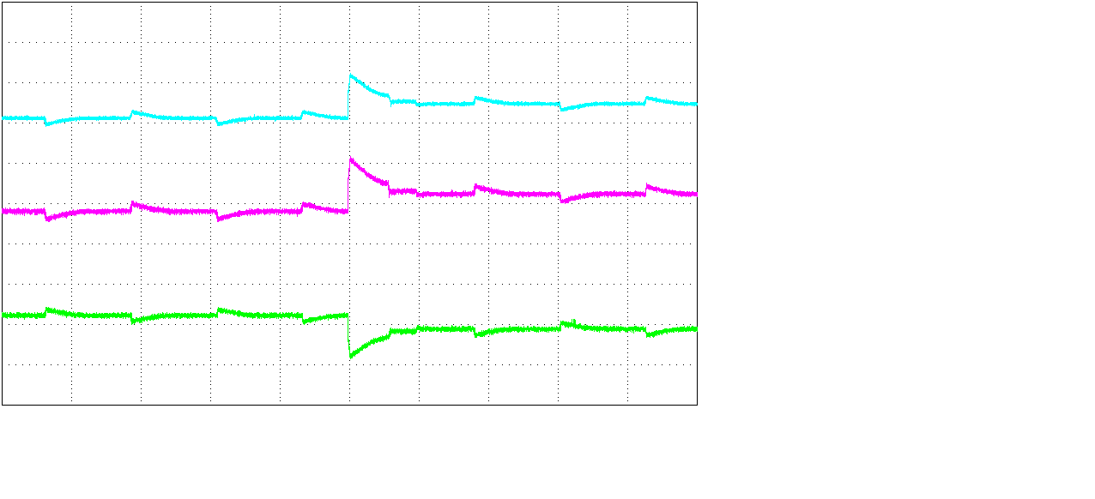
(a)
(b)
(c)
(d)
Fig. 11. Experimental results of CTC for periodical step command. (a) Speed tracking response and tracking error at case 1. (b) Stator current and d-q axis current commands at case 1. (c) Speed tracking response and tracking error at case 2. (d) Stator current and d-q axis current commands at case 2.

Slide 15
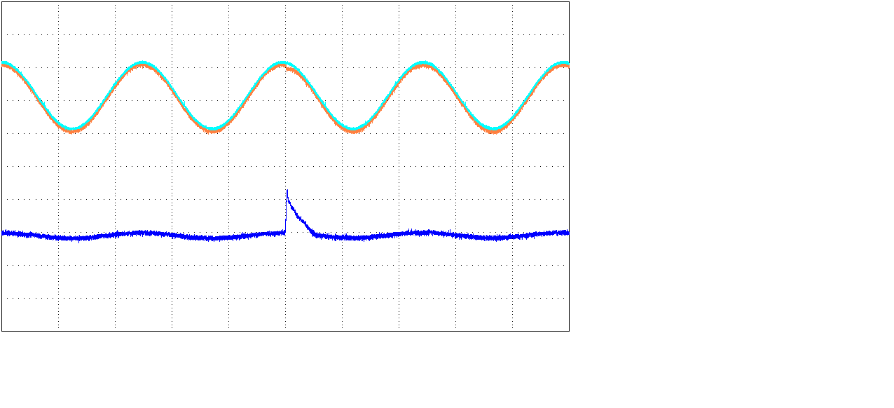
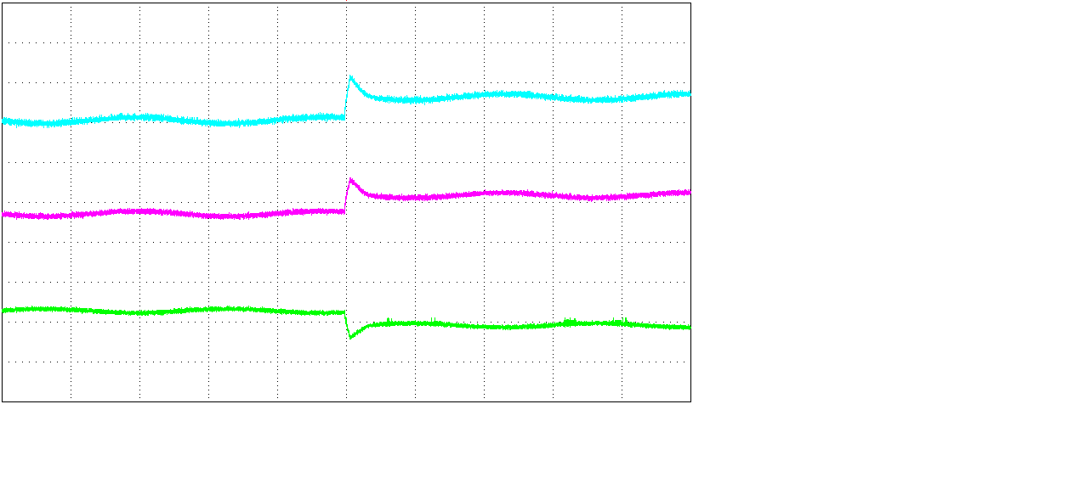
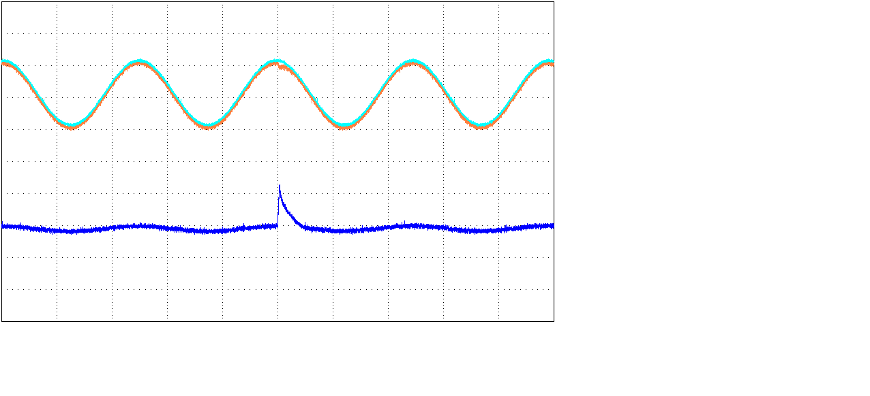
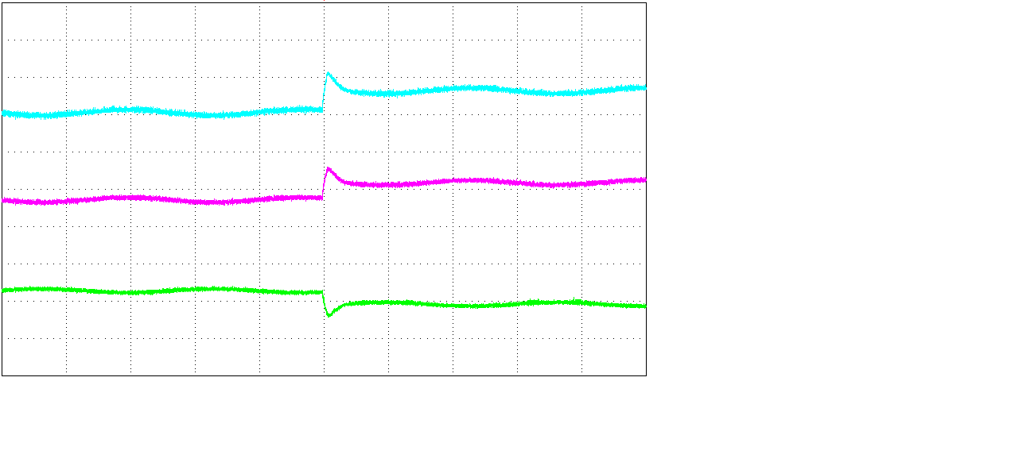
(a)
(b)
(c)
(d)
Fig. 12. Experimental results of CTC for periodical sinusoidal command. (a) Speed tracking response and tracking error at case 1. (b) Stator current and d-q axis current commands at case 1. (c) Speed tracking response and tracking error at case 2. (d) Stator current and d-q axis current commands at case 2.

Slide 16
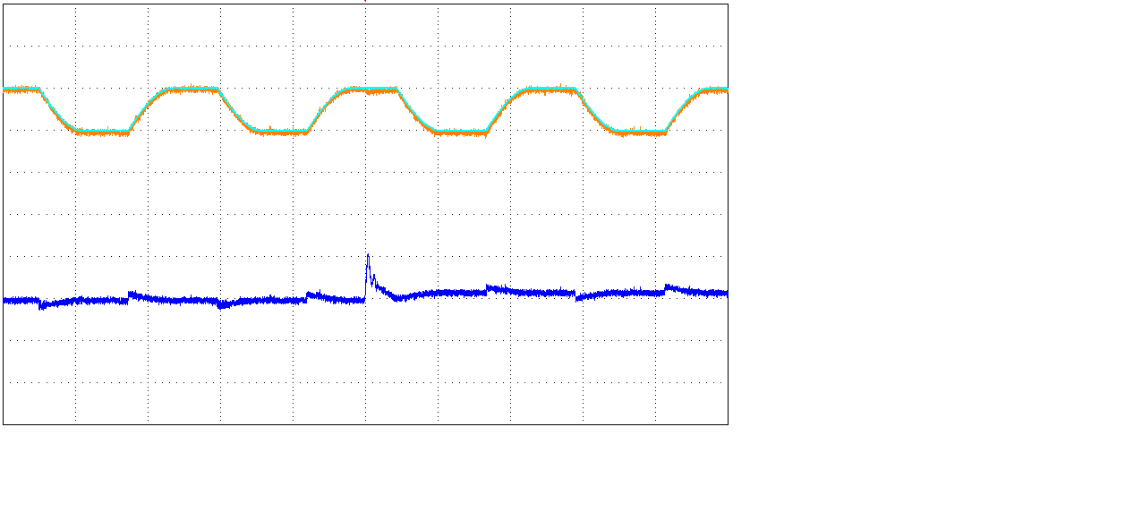
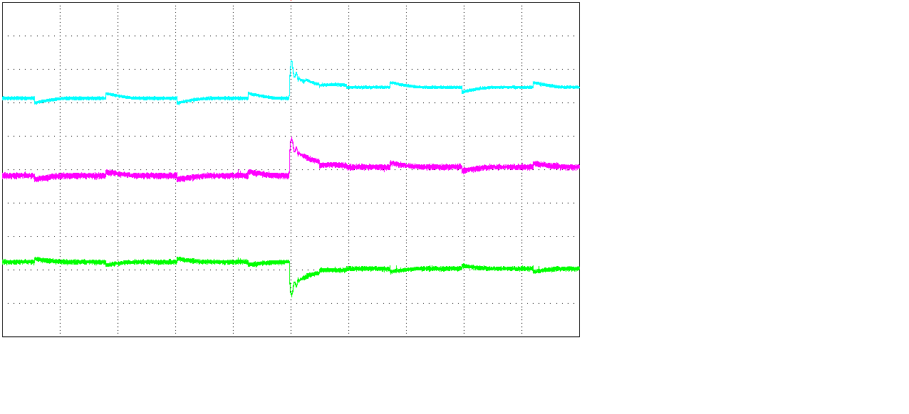
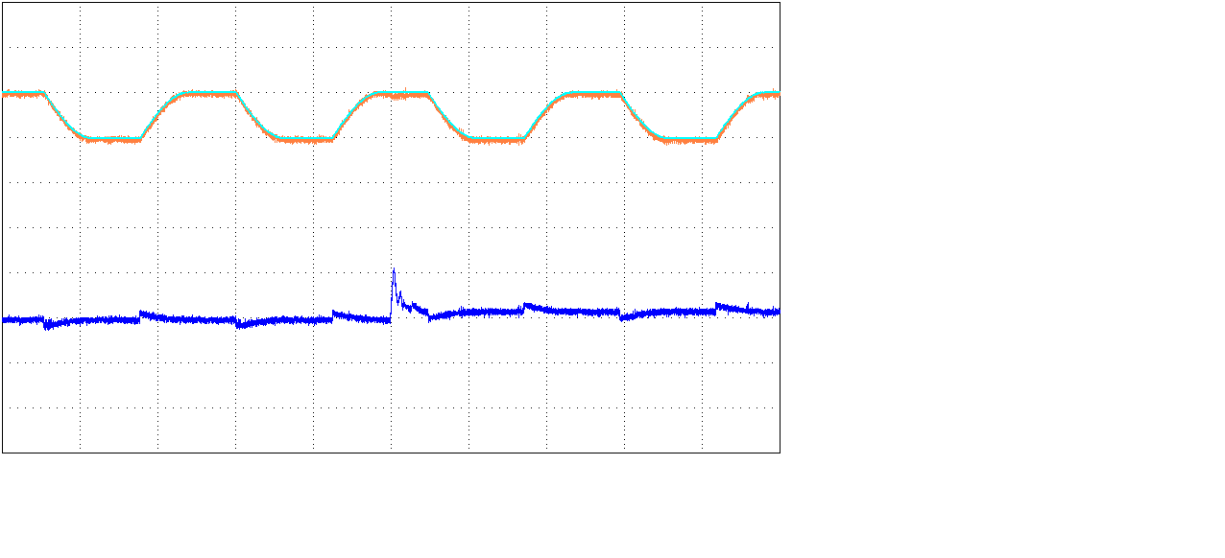
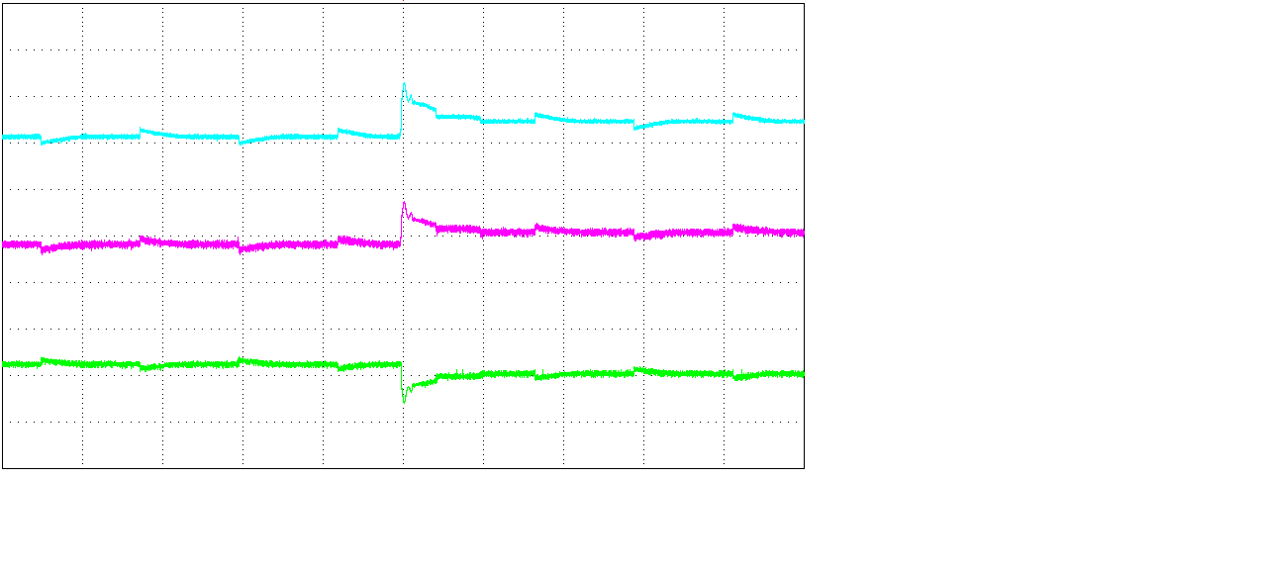
(a)
(b)
(c)
(d)
Fig. 13. Experimental results of ICTCRLFNN for periodical step command. (a) Speed tracking response and tracking error at case 1. (b) Stator current and d-q axis current commands at case 1. (c) Speed tracking response and tracking error at case 2. (d) Stator current and d-q axis current commands at case 2.

Slide 17
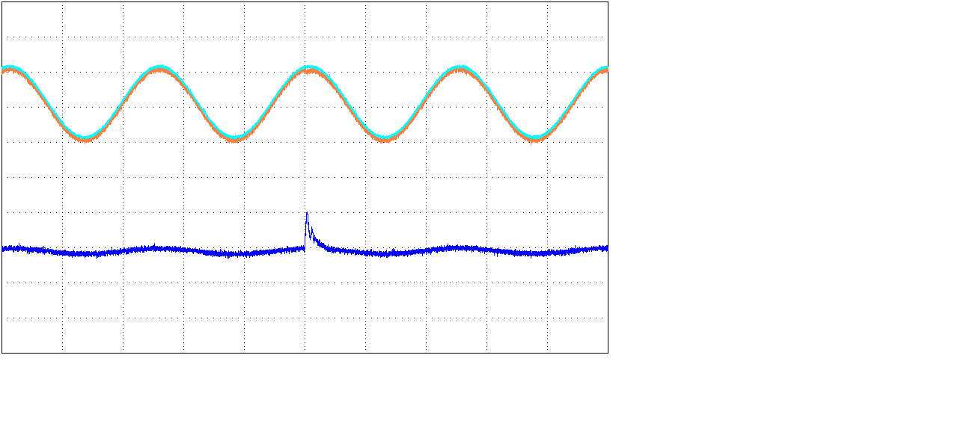
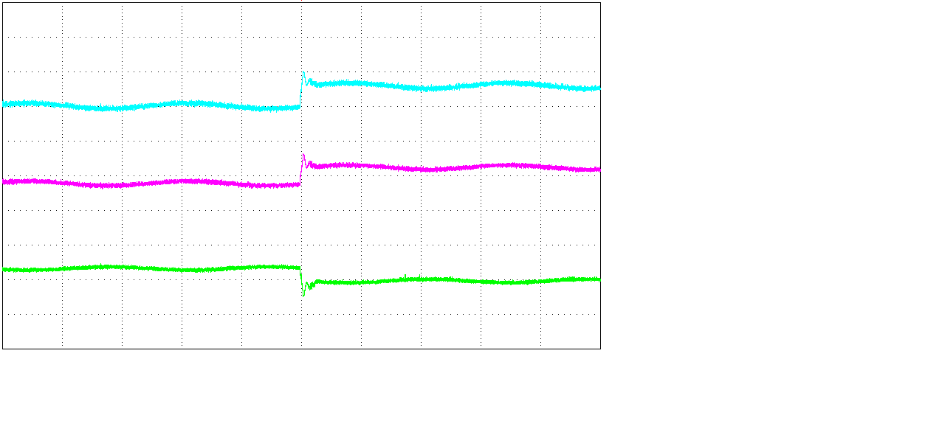
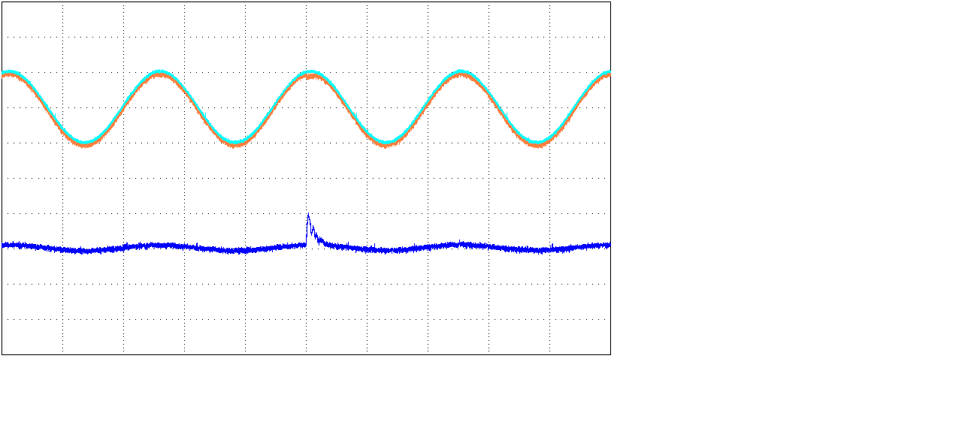

(a)
(b)
(c)
(d)
Fig. 14. Experimental results of ICTCRLFNN for periodical sinusoidal command. (a) Speed tracking response and tracking error at case 1. (b) Stator current and d-q axis current commands at case 1. (c) Speed tracking response and tracking error at case 2. (d) Stator current and d-q axis current commands at case 2.

Slide 18
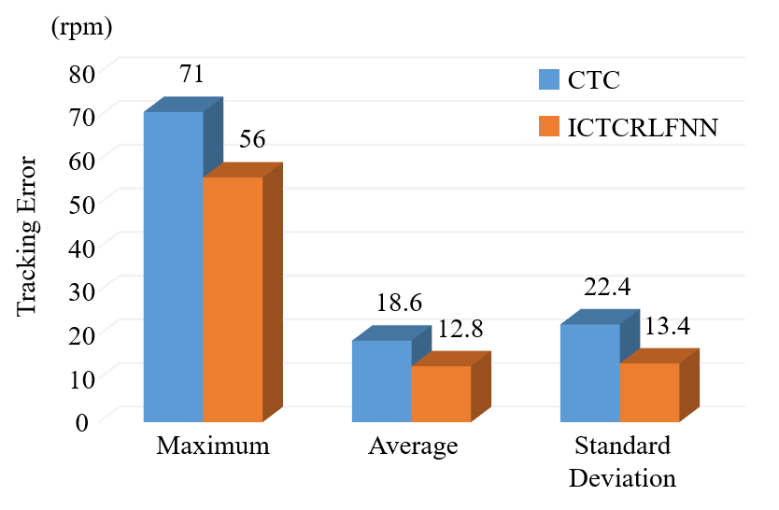
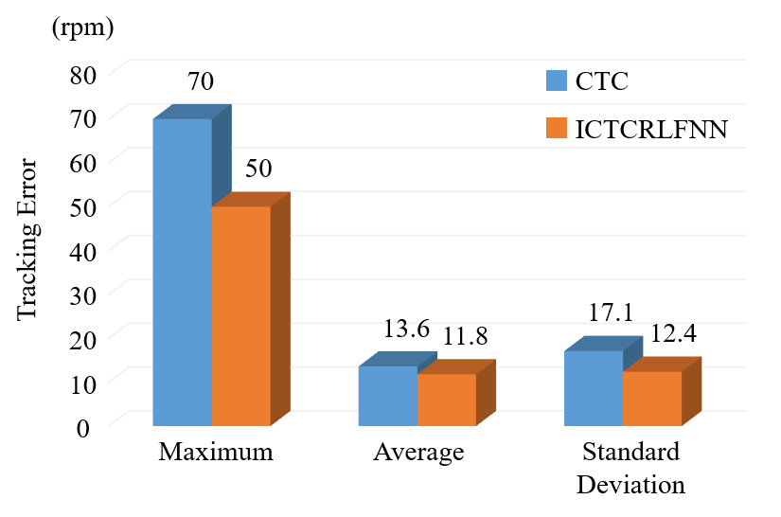
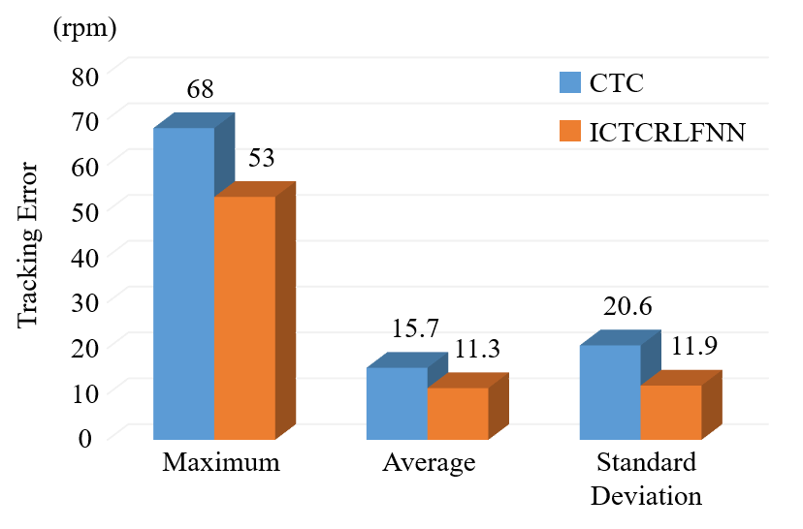
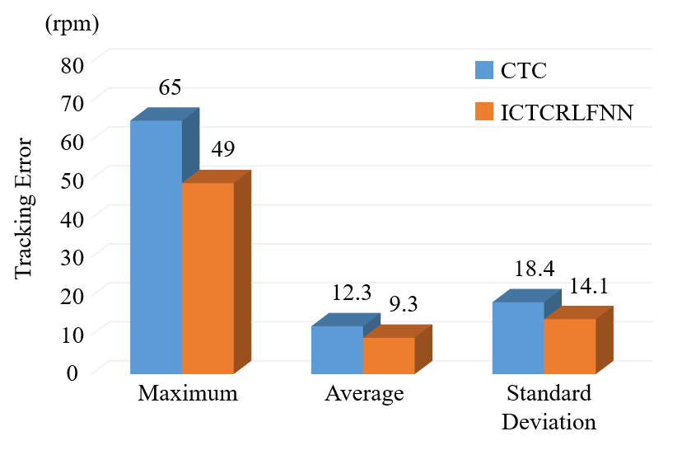
(a)
(b)
(c)
(d)
Fig. 15. Maximum, average and standard deviation of tracking errors CTC and ICTCRLFNN. (a) Step command at case 1. (b) Sinusoidal command at case 1. (c) Step command at case 2. (d) Sinusoidal command at case 2.

